Slide 1

Emotion Recognition from Coloring Tasks:
A Comparative Study on the Performance of CNN Variants
Made by:
Riddhita Chakraborty,
Shreya Majumdar

Slide 2
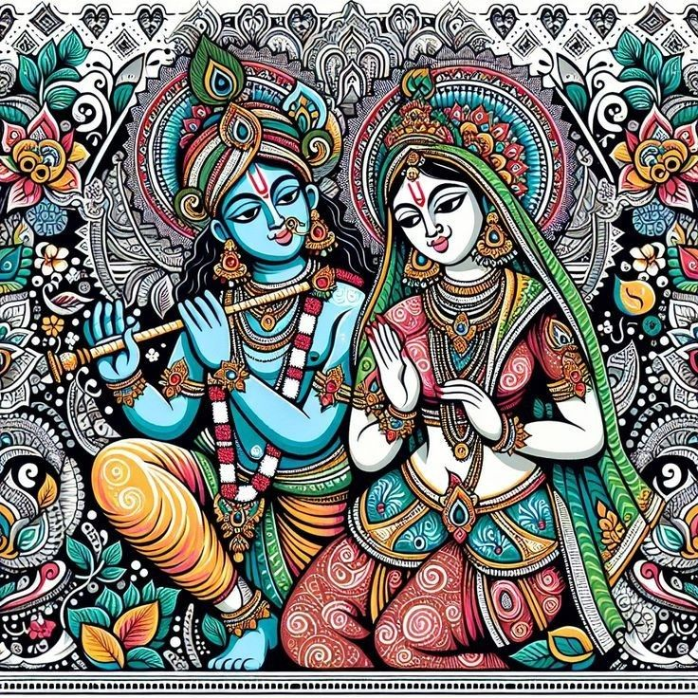
Agenda:
Introduction: The Role of Emotions and Color in
Human Computer Interaction (HCI)
Background: Previous Studies and Color Psychology
Proposed Methodology: Color Extraction and
CNN Classifications
Model Interpretability: LRP and Grad-CAM
Experimental Results and Performance Evaluation
Conclusion and Future Directions

Slide 3
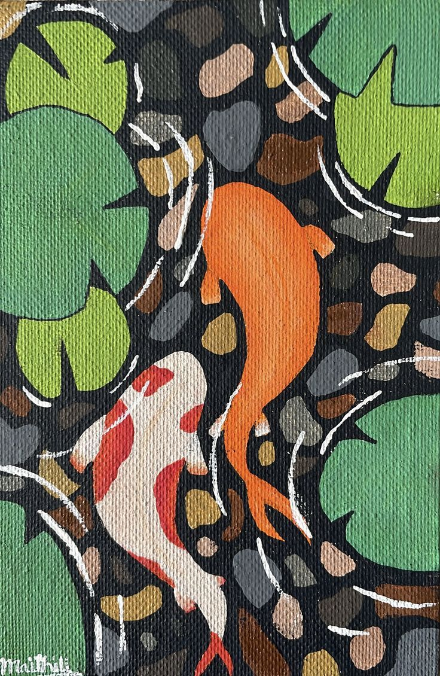
Introduction: Emotion Recognition Through Art
Emotion recognition is vital for understanding human behavior. While facial expressions and voice are common, this research explores detecting emotions from coloring patterns.
Individuals subconsciously choose colors aligned with their mood. Analyzing these patterns in coloring tasks offers non-invasive insights into emotional states.

Slide 4
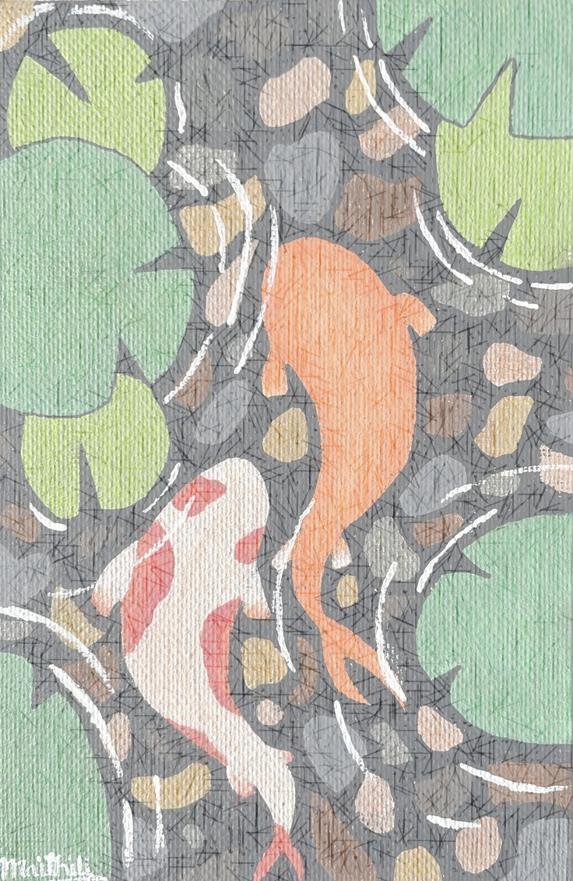
Background and Dataset description:
Color Psychology & Emotion
We created a curated dataset of 770 colored images from four traditional Indian art forms—Warli, Gond, Madhubani, and Mandala—with each category nearly equally represented. Standardized monochromatic line art was selected to maintain visual consistency while preserving each style’s uniqueness. Participants were invited to color these images freely, using any medium or color scheme they preferred. After completing the coloring task, they self-reported their emotional state as positive, neutral, or negative. Each image was then labeled accordingly, forming a balanced dataset that links artistic interaction and emotional response. This dataset provides a unique foundation for exploring emotion recognition in traditional art using color-based features and supports the development of machine learning models in this space.
Red: High Arousal, Negative
Blue & Green: Positive, Tranquil
Associated with anger, dominance, and threat. Enhances perception of anger and activates attention to threats.
Blue conveys calmness and introspection. Green evokes nature, fertility, and well-being, reducing heart rate.

Slide 5

Literature Survey:
Emotion Detection Methods: Prior research has utilized facial analysis, EEG signals, and sentiment
analysis for emotion recognition, with machine learning proving effective.
Color-Emotion Link: Studies highlight strong cross-cultural associations between colors and
emotions, emphasizing their psychological and semantic significance.
Deep Learning in Visual Arts: Deep learning frameworks, especially CNNs, are effective in analyzing
emotional cues in colored artworks by learning both low- and high-level
features.
Color Psychology: Red is linked with high-arousal negative emotions (e.g., anger, dominance), while
blue and green are associated with calmness, divinity, and harmony.
Gap in Research: There is a notable lack of interactive emotion recognition systems based on creative
activities like coloring, suggesting a direction for future work.

Slide 6
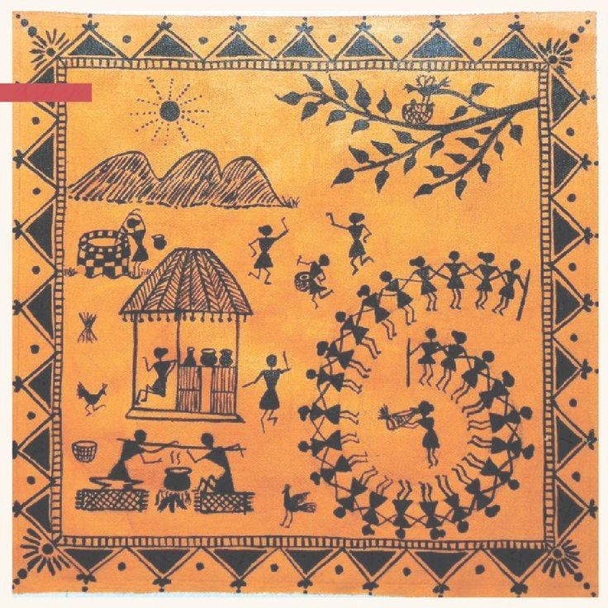
Proposed Methodology: CNN-Based Classification
Our approach leverages Convolutional Neural Networks (CNNs)
to classify emotions from colored images,
considering hue, saturation, and contextual semantics.
Key Steps:
Image preprocessing :Image resizing, RGB extraction,
Normalization, Augmentation
CNN Classification (CNN, 2DCNN, LeNet5, ResNet50,
AlexNet, VGG-16)
Classification of emotions reported by users to RGB class

Slide 7

CNN Variants for Emotion Recognition
CNN
2DCNN
Adapted for RGB images, efficient for general color
classification.
Adapted for RGB images, efficient for spatial feature-based color classification.
LeNet5
ResNet50
Adapted for RGB images, efficient for low-complexity color classification.
Uses skip connections to address vanishing gradients in deep networks.
AlexNet
VGG-16
Designed for RGB image classification, capturing large-scale color and edge features.
Leverages pre-trained architecture with small 3x3 filters for hierarchical feature learning.

Slide 8
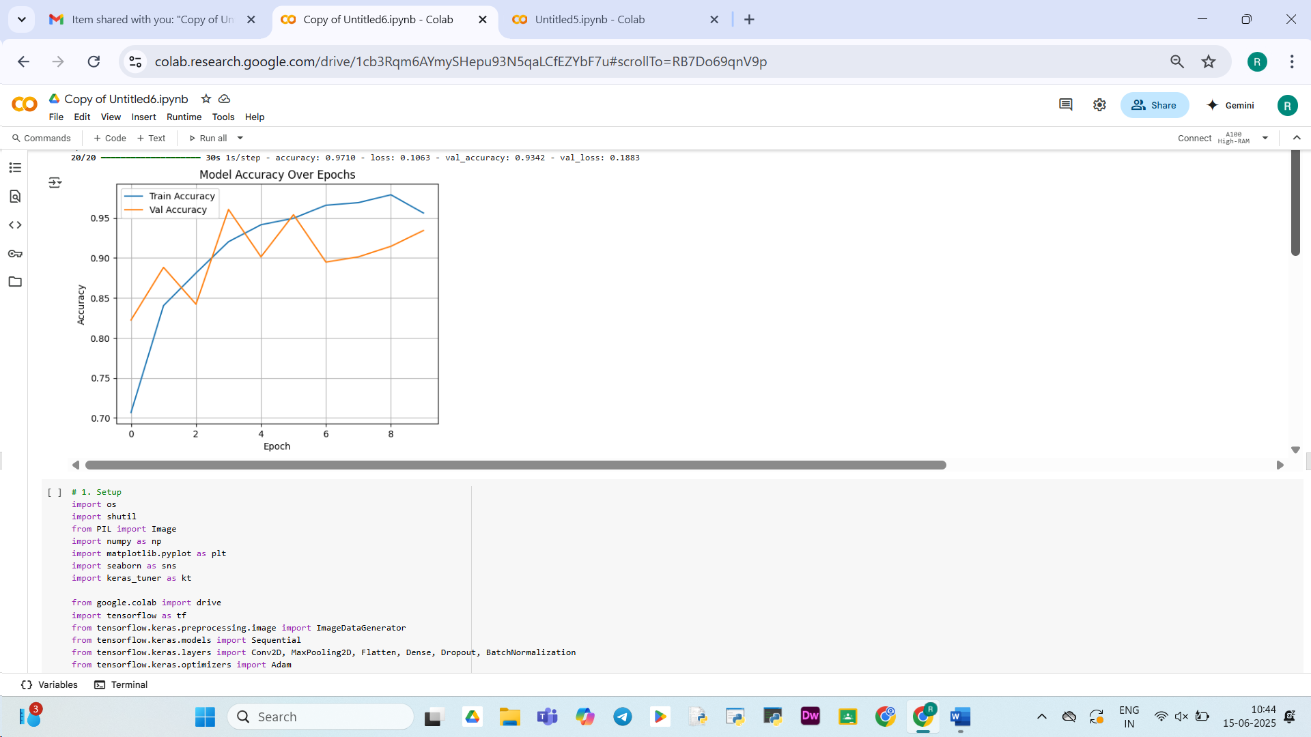
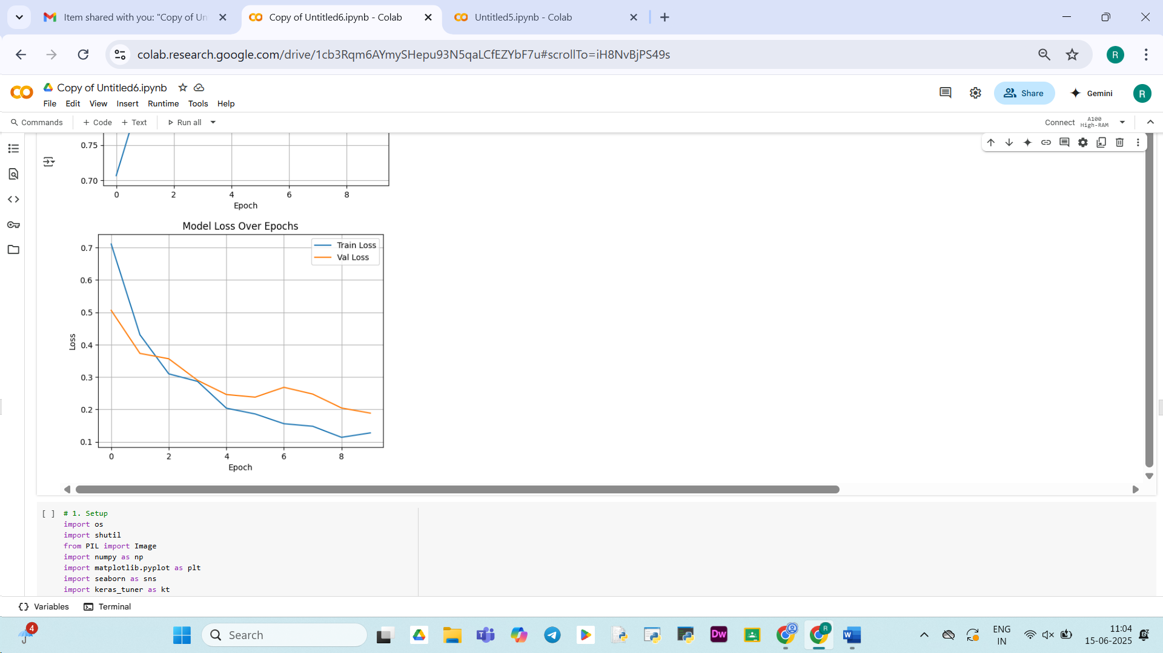
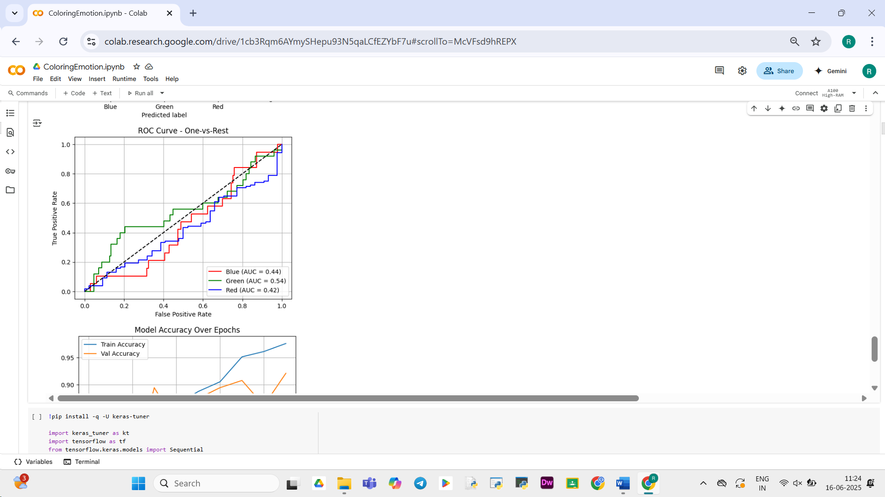
Experimental Results and Performance Evaluation
Tuned LeNet5 outperformed other CNNs with 94.74% accuracy in dominant color recognition.
Evaluation Metrics:
Learning Curves: Model performance over time.
Confusion Matrix: Evaluates classification model performance.
ROC Curve: Plots True Positive Rate vs. False Positive Rate.

Slide 9
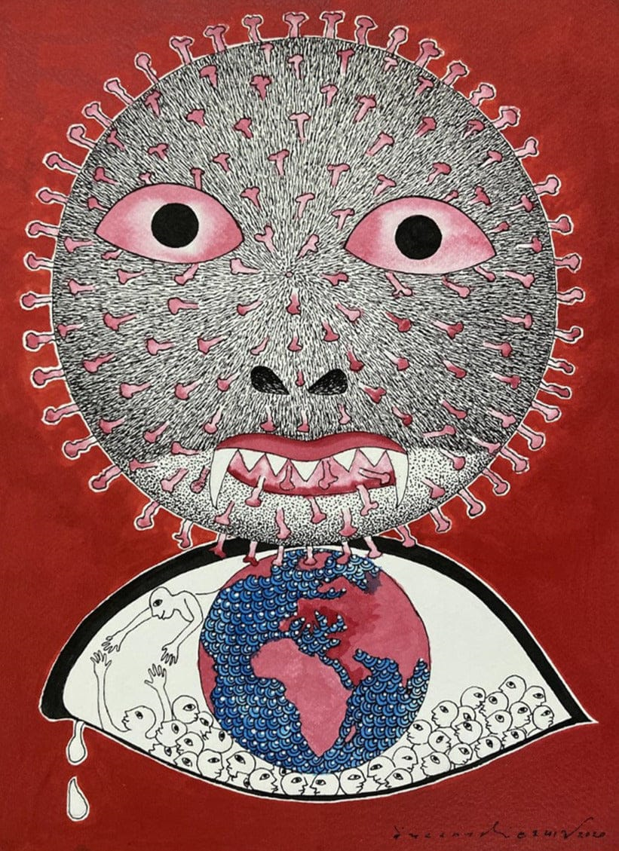
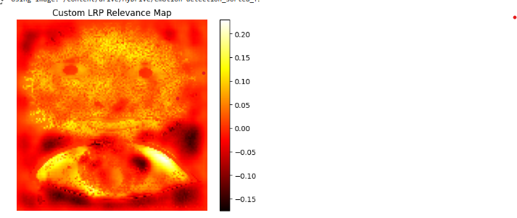
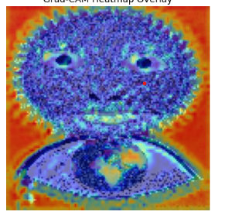
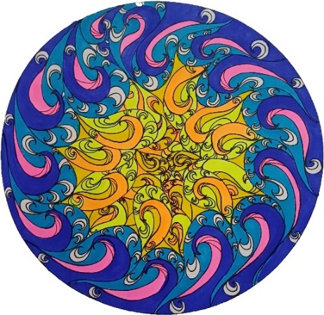
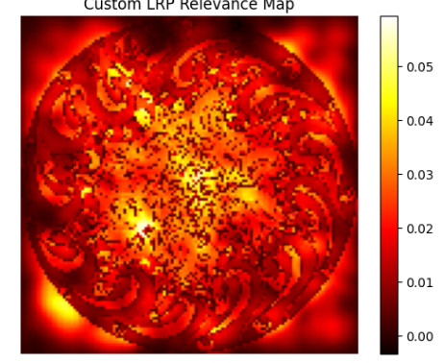
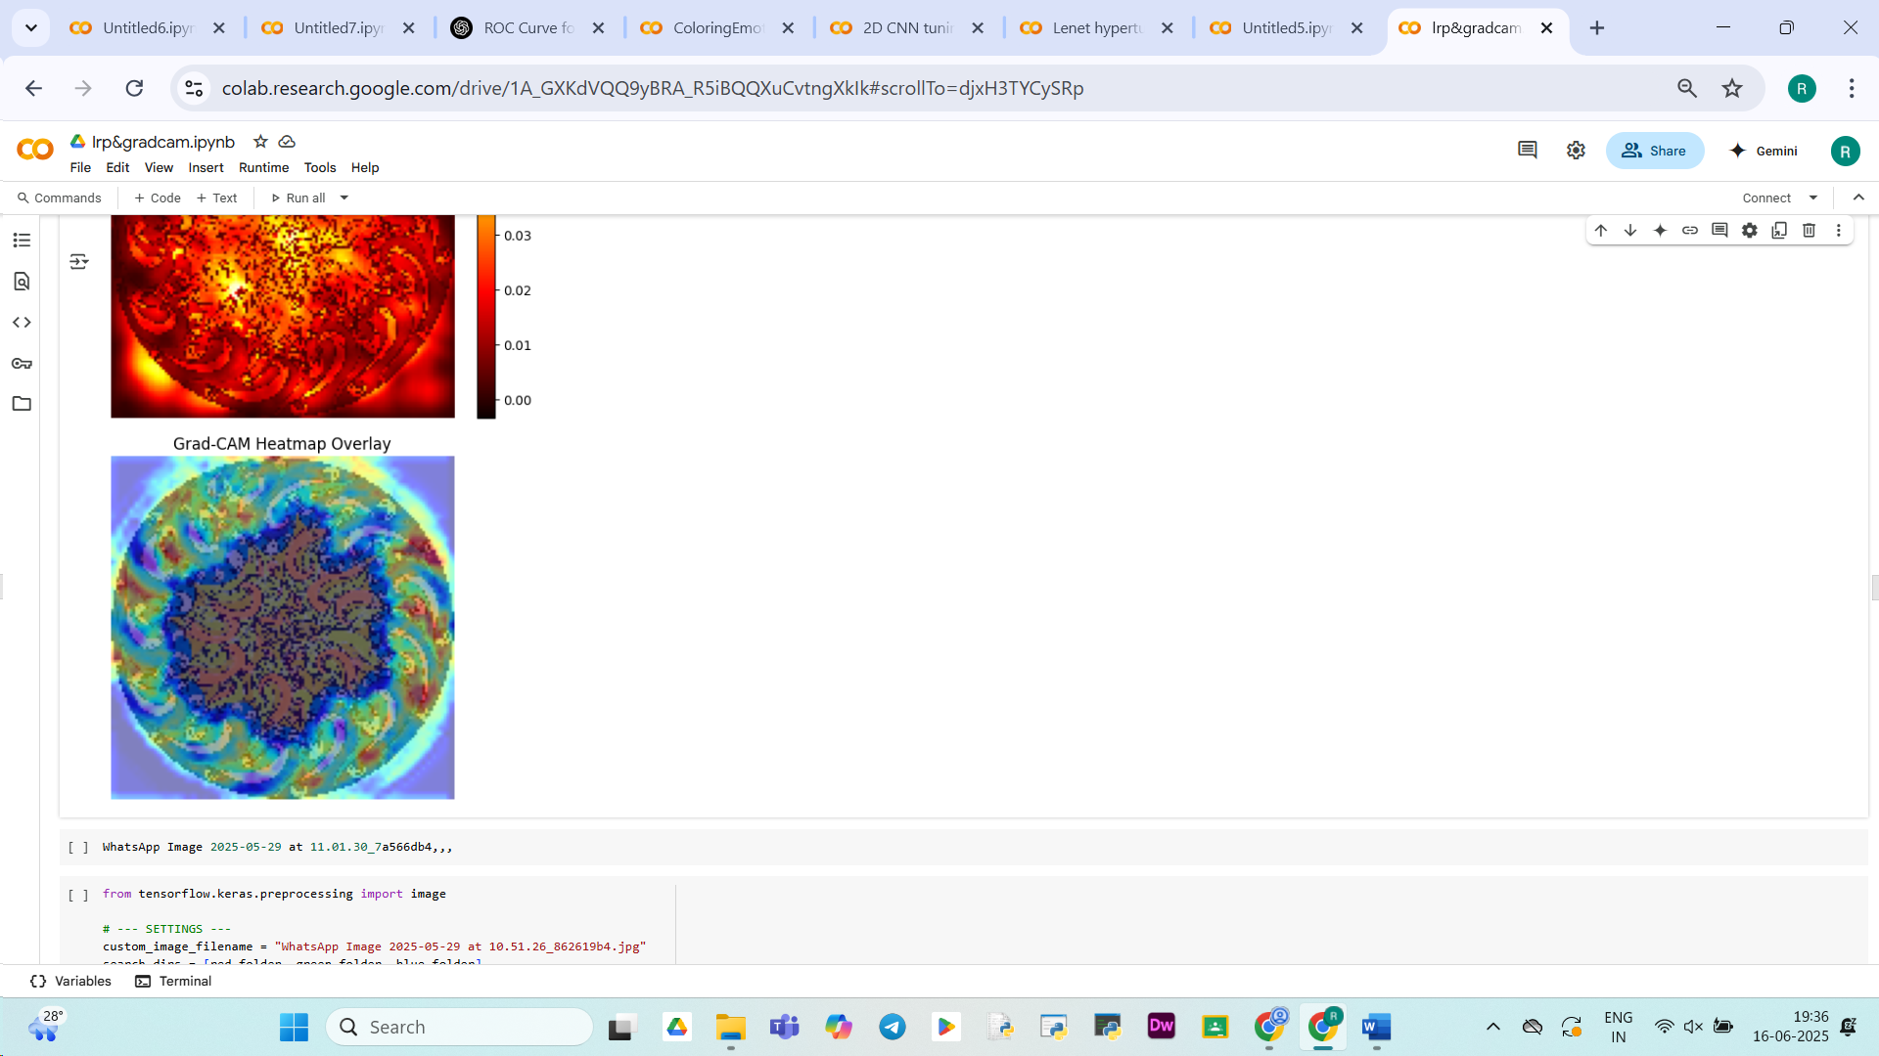

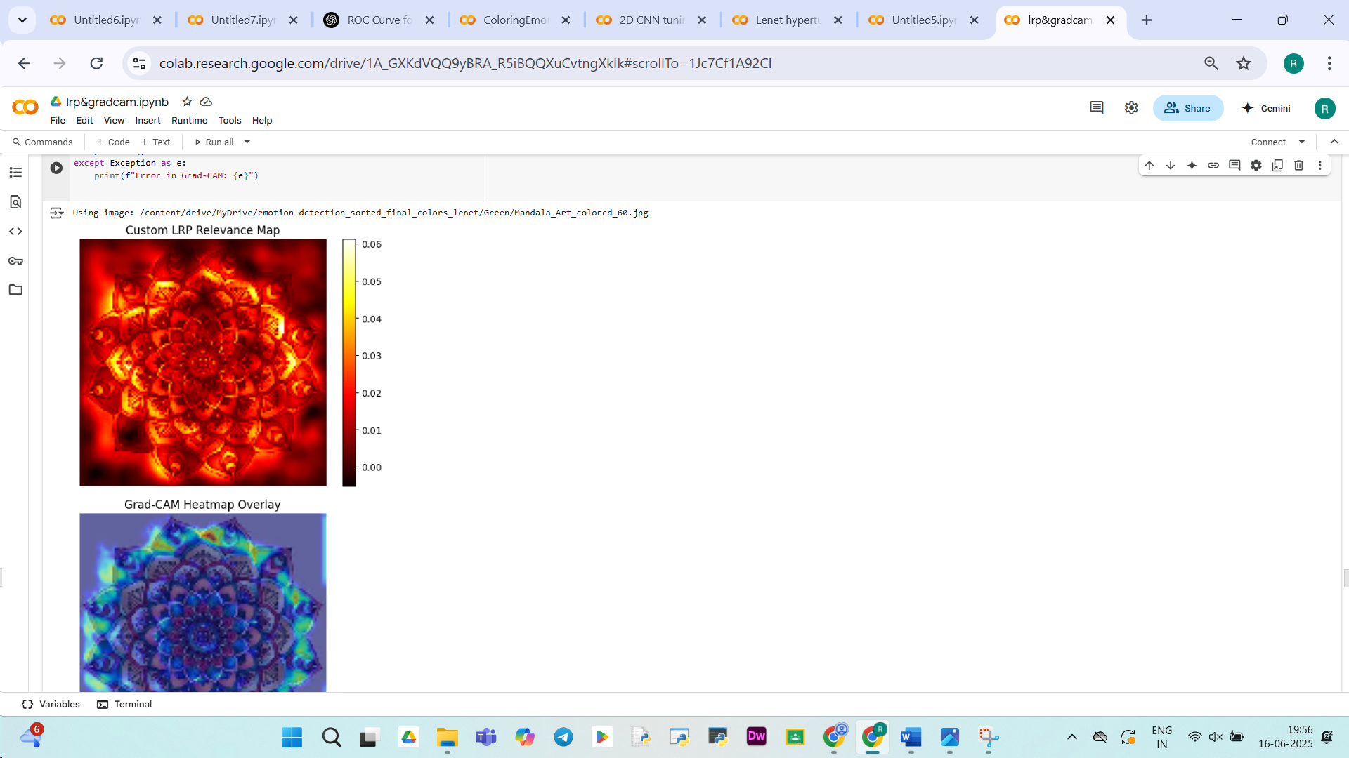
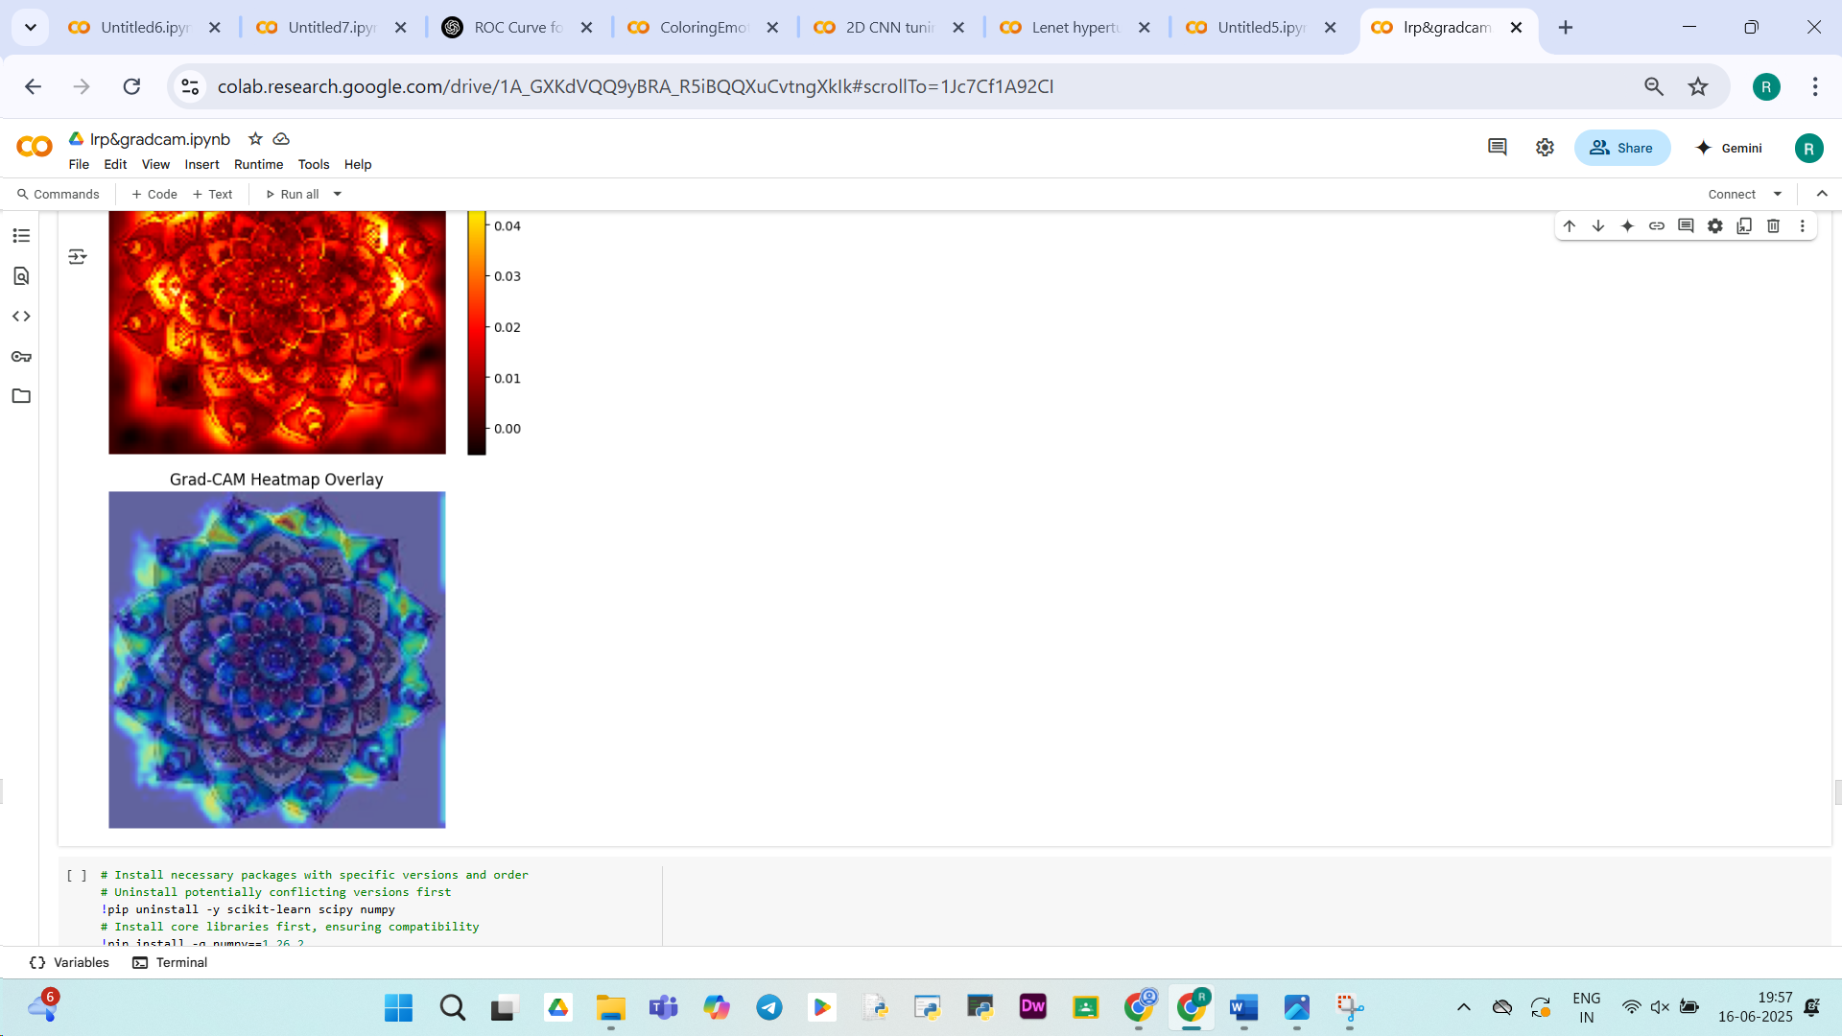
RED
Model Interpretability: LRP and Grad-CAM
BLUE
To ensure transparency, we integrate Layer-wise Relevance Propagation (LRP) and Grad-CAM for post-hoc model explanation.
Layer-wise Relevance Propagation (LRP)
Grad-CAM
GREEN
Decomposes model output to highlight input features most responsible for the decision, providing fine-grained interpretability.
Leverages gradients to produce a coarse localization map, highlighting influential regions in the input image for prediction.
GRADCAM visualizations for one image from each class

Slide 10
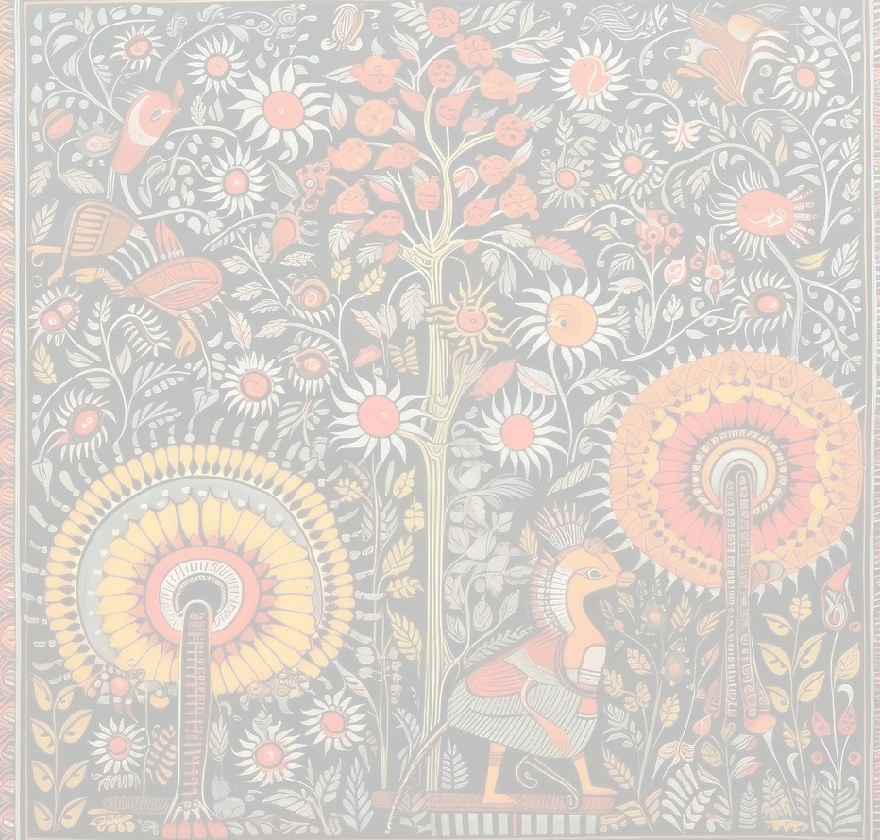
Conclusion and Future Directions
This research significantly advances explainable AI systems for emotion recognition by making CNN models interpretable.
Combining advanced CNN techniques with explainable AI methods enhances performance and transparency, paving the way for reliable applications in psychological diagnostics and human-computer interaction systems.

Slide 11
References:
Picard, R. W. (1997). Affective computing. MIT Press.
McDuff, D., & Kaliouby, R. E. (2015). Affectiva: technology for measuring and communicating emotion. Proceedings of the 2015 ACM International Joint Conference on Pervasive and Ubiquitous Computing.
Jonauskaite, D., et al. (2019). A machine learning approach to quantify the specificity of colour–emotion associations and their cultural differences. Royal Society Open Science.
Marcus, A. (1992). Graphic design for electronic documents and user interfaces. ACM Press.
Werner, T., et al. (2021). Mood Adaptive Display Coloring: Utilizing Modern Machine Learning Techniques and Intelligent Coloring to Influence the Mood of PC Users. ACHI 2021.
Yildirim, I., et al. (2021). Color and Sentiment: A Study of Emotion-Based Color Palettes in Marketing. arXiv:2407.16064.
Nie, T., & Lv, X. (2021). Deep Learning-Based Machine Color Emotion Generation. IJACSA.
Shagyrov, M., & Shamoi, P. (2024). Color and Sentiment in Marketing. SCIS & ISIS 2024, IEEE.
Elliot, A.J., & Aarts, H. (2011). Perception of the color red enhances the force and velocity of motor output. Emotion, 11(2), 445.
Venhoeven, L.A., Bolderdijk, J.W., & Steg, L. (2020). Why going green feels good. Journal of Environmental Psychology, 71, 101492.
Clarke, T., & Costall, A. (2008). The emotional connotations of color: A qualitative investigation. Color Research & Application, 33(5), 406-410.
Jonauskaite, D., et al. (2019). [See ref. 3]
Doma, V., & Pirouz, M. (2020). A comparative analysis of machine learning methods for emotion recognition using EEG and peripheral physiological signals. J Big Data, 7, 18.
Achlioptas, P., et al. (2021). ArtEmis: Affective Language for Visual Art. CVPR.
Glowinski, D., et al. (2015). Towards a minimal representation of affective gestures. ACII 2015, IEEE, 498–504.

Slide 12

THANK YOU

